Slide 1

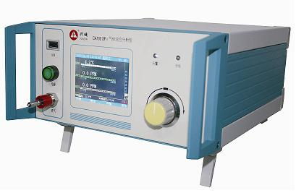
Gas ANALYZER
KEY FEATURE:
H2S detecting (0-100ppm, ±2ppm error)
SO2 detecting (0-100ppm, ±2ppm error)
CO detecting (0-500ppm, , ±5ppm error)
Data storage & recall
User defined calibration.
Portable.
Flow-meter, thermometer.
User interface (LCD, keyboard, dial)
Cordless

Slide 2
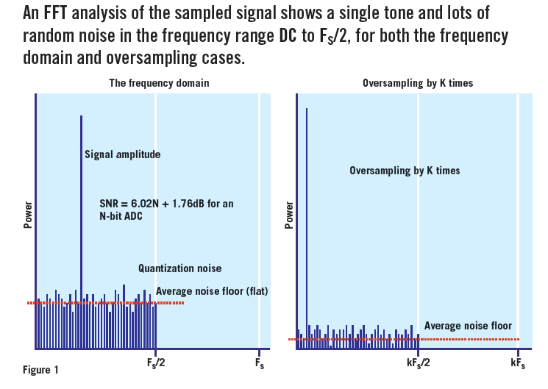
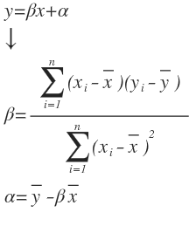
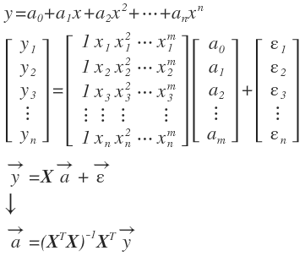
Oversampling
Linear & 2+ Orders Polynominal Regression
DAUM Equation Editor:
y=\beta x+\alpha \\ \downarrow \\ \beta =\frac { \sum _{ i=1 }^{ n }{ ({ x }_{ i }-\overline { x } )({ y }_{ i }-\overline { y } ) } }{ \sum _{ i=1 }^{ n }{ { ({ x }_{ i }-\overline { x } ) }^{ 2 } } } \\ \alpha =\overline { y } -\beta \overline { x } \\
{ y }={ a }_{ 0 }+{ a }_{ 1 }{ x }+{ a }_{ 2 }{ x }^{ 2 }+\cdots +{ a }_{ n }{ x }^{ n }\\ \left[ \begin{matrix} { y }_{ 1 } \\ { y }_{ 2 } \\ { y }_{ 3 } \\ \vdots \\ { y }_{ n } \end{matrix} \right] =\left[ \begin{matrix} 1 & { x }_{ 1 } & { x }_{ 1 }^{ 2 } & \cdots & { x }_{ 1 }^{ m } \\ 1 & { x }_{ 2 } & { x }_{ 2 }^{ 2 } & \cdots & { x }_{ 2 }^{ m } \\ 1 & { x }_{ 3 } & { x }_{ 3 }^{ 2 } & \cdots & { x }_{ 3 }^{ m } \\ \vdots & \vdots & \vdots & \quad & \vdots \\ 1 & { x }_{ n } & { x }_{ n }^{ 2 } & \cdots & { x }_{ n }^{ m } \end{matrix} \right] \left[ \begin{matrix} { a }_{ 0 } \\ { a }_{ 1 } \\ { a }_{ 2 } \\ \vdots \\ { a }_{ m } \end{matrix} \right] +\left[ \begin{matrix} { \varepsilon }_{ 1 } \\ { \varepsilon }_{ 2 } \\ { \varepsilon }_{ 3 } \\ \vdots \\ { \varepsilon }_{ n } \end{matrix} \right] \\ \vec { y } =X\vec { a } +\vec { \varepsilon } \\ \downarrow \\ \vec { a } ={ ({ X }^{ T }X) }^{ -1 }{ X }^{ T }\vec { y } \\

Slide 3
Gas ANALYZER
POINTS OF DIFFICULTIES:
Accuracy optimizing.
Algorithm and experiments of SO2, H2S, CO including 7-points least square, Temperature correction, Co-reaction deduction, Initial-state compensation.
Friendly GUI

Slide 4
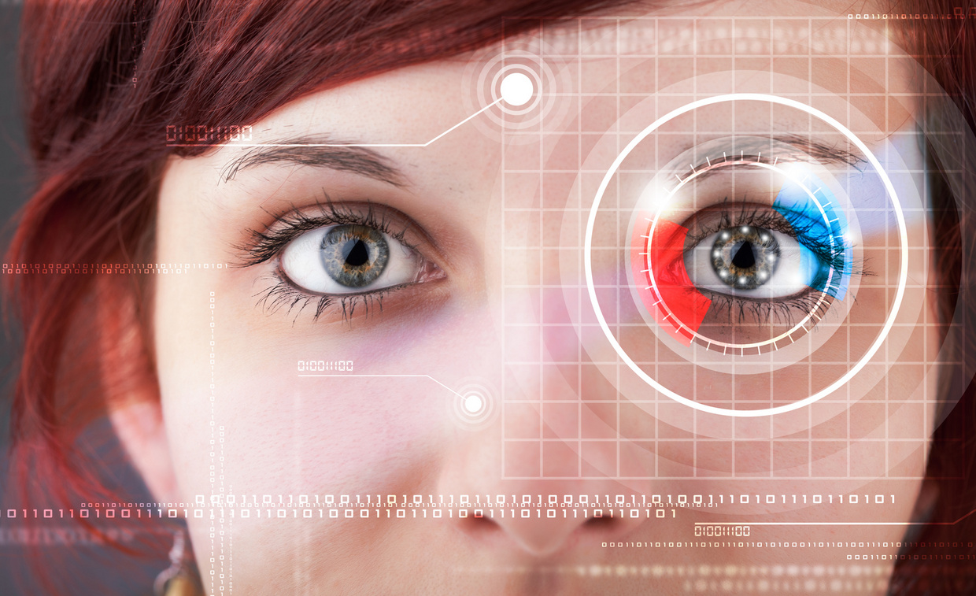
Iris recognition device
KEY FEATURE:
Double eyes iris recognition simultaneously.
LCD mirror aiming guide.
30 FPS, real time recognition.
Network connection.
User-friendly interaction.
Data storage support.
Audio and Ad broadcasting.
Industrial EMC\EMI.

Slide 5
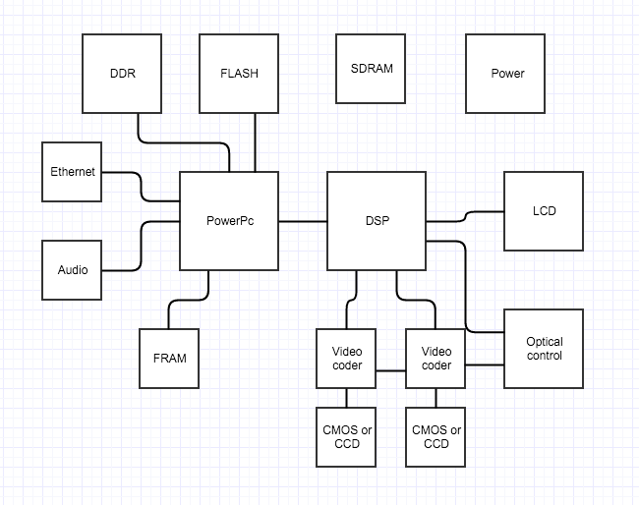
Iris recognition device
DIAGRAM:

Slide 6
Iris recognition device
POINTS OF DIFFICULTIES:
Transplanting linux to MPC8313 and S3C2410
RTOS on DM642
Drivers on linux

